Slide 1




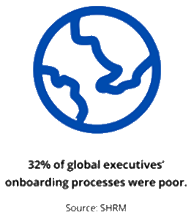
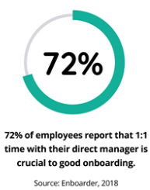
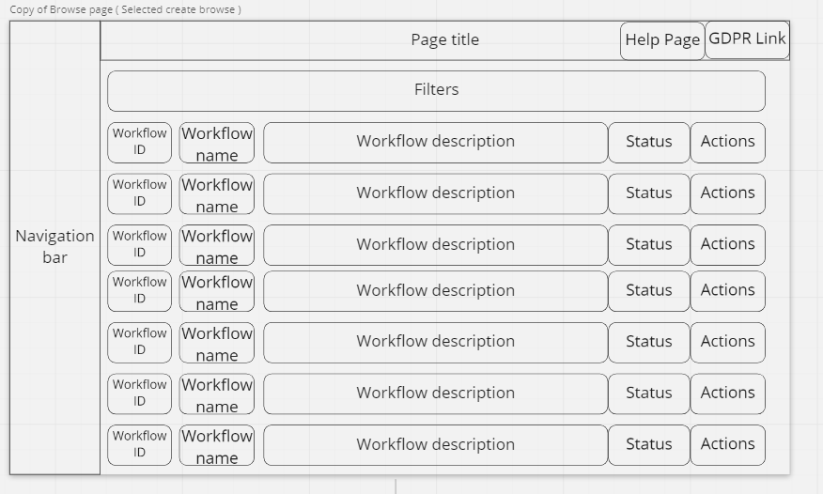
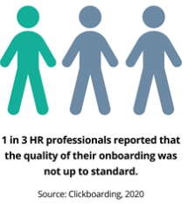
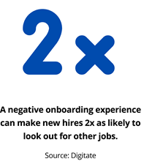






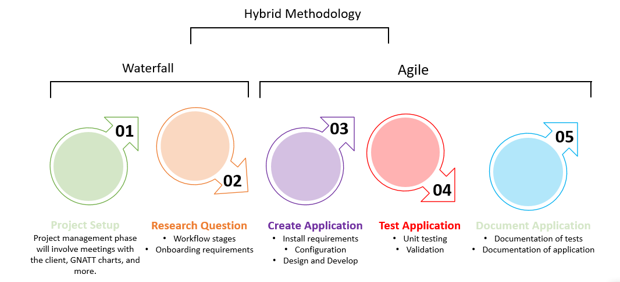
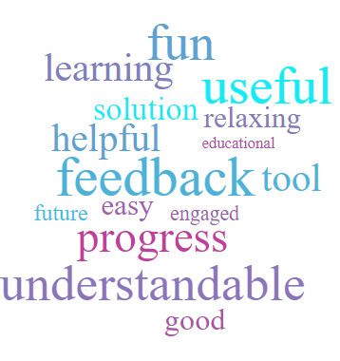
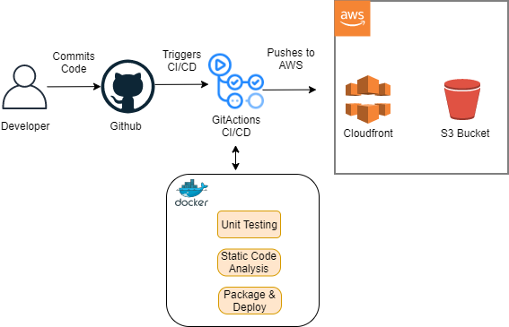
>.
Can Adapting A Workflow Builder Tool Improve the Effectiveness and Result Over Traditional Methods of the Onboarding Process?
DTSL7 – Digital And Technology Solutions Specialist (MSc)
Supervisor: Paul Graham paul.graham@sunderland.ac.uk
Alan Heslop - bh83dl@student.sunderland.ac.uk
Introduction
§v
Problem Context:
Onboarding is vital for the growth of every organisation. However, ongoing challenges can hinder that growth for companies and new employees.
Over 1/3 of companies do not have a structured onboarding process.
The consequences of poor onboarding had led to a major cause of employee turnover.
Project Requirements:
This workflow system can highlight the potential benefit to creating a process which guides the user/hire through a particular process.
Results
Browse workflow page will allow the user to select their next packaged workflow (a packaged workflow is a collection of inbuilt steps).
Step page will allow the user to complete each required step before completing the workflow.
Aims & Objectives
§v
Approach
We aimed to design, develop, and implement a Proof of Concept (PoC) to support recruitment through the onboarding process using a workflow system, which provides a 1-2-1 contact with multiple levels of management.
The onboarding objectives were to:
Requirements and Elicitation
Within this section we found that we could use requirements discovery to find the best methods for the customer, requirements workshops to best understand how to perform the methods correctly, and survey (before and after) to better understand the target audience and track progress metrics.
Requirements Discovery
Requirements Workshops
User page – will entitle the manager and user to be able to track their progress, whilst using functional visual aids to help ease the recruitment and retention of new staff.
As a PoC, this could be implemented to the wider staff groups (cleaners, security, etc).
Objective #1
Implement a working PoC utilising full stack front-end and backend concurrent technologies.
Meetings with the client helped to facilitate gathering the facts for the PoC into functional and non-functional requirements.
The workshop will involve understanding the issue, and how to implement a PoC to overcome the current system.
Objective #2
Design a visual front-end to provide the user with the required details.
Survey
Objective #3
A survey will be produced to measure a new hire’s feedback on using the workflow system.
The metrics will be based on a star system (1-5), helping to understand area’s which may need monitoring and improving.
Design, create, and implement a backend to effectively manage user process with CRUD ability.
Objective #4
Process and Methodology
Implement and utilise the CI/CD process using GitHub actions to align more to an Agile method.
Hybrid methodology; Waterfall and Agile would suit this project. As technology is adapting, an iterative approach would used to adapt to changes and influence inputs from the qualitative feedback from user evaluations.
§v
Conclusion
The final product for the PoC met the requirements of the client, who were extremely satisfied of the work carried out and the results. The outcome from the client-side is to collect all information, resources, and links in order to pass this across to a “testing team” for their own development piece. The proposed idea of creating departmental workflows was met with excitement, instead of using the current standard of one size fits all.
Objective #5
Implement a CI/CD pipeline for continuous improvement of code.
Literature Review
Covid-19 Onboarding
The Covid-19 outbreak created a new dynamic across the globe. The outbreak changed face-to-face meetings, and began virtual working as a primary method. Studies have shown that challenges with onboarding are often around introducing employees to the organisation and culture of the teams (Bauer, 2010).
Onboarding needs to become current, and build on the foundation of the 4C’x`S.
Feedback received (some shown opposite) also identified that the PoC was “up to date, and what the company was missing.”.
System Overview
In conclusion, it has been shown that the onboarding tool can improve collaboration, retention, and decrease employee turnover which have been identified previously as required areas of improvement.
Using the CI/CD Pipeline helped to keep the code consistent and run through unit tests to ensure the code is safe.
Overall, the feedback was great because I managed this project, set guidelines and timeline and really explored how to improve the organisation in an area it was lacking.
Using a serverless approach, this gives us the ability to commit code to the GitHub repo which triggers a continuous integration testing workflow. The workflow will check consistency in quality of code such as linting, unit testing, and static code analysis.
References
Bauer, T., 2010. Onboarding New Employees: Maximizing Success.
Notes:
Over 1/3 of companies do not have a structured onboarding process (https://www.businessnewsdaily.com/9936-consequences-poor-onboarding.html)
Employee members image (https://www.pngitem.com/middle/hmhoJRb_happy-employees-transparent-background-hd-png-download/)
Onboarding flow image https://www.pngegg.com/en/png-xofzy
Employee empowerment (https://www.pngegg.com/en/png-pbwgj)
Statistical introduction: https://www.oak.com/blog/employee-onboarding-statistics/

